Slide 1

SENTIMENT ANALYSIS ON CONSUMER PERCEPTION USING SOCIAL MEDIA
Guided To:
Er. Piyush Rai
Asst. Prof (CSE)
Submitted By:
Ravi Kumar :-18138
Shailendra Kumar :-18145
Vijay Kumar :-18156

Slide 2
Outline
Introduction
Challenges
Methodology Process
Filtering Method
Results
Conclusion
Bibliography
Sentiment Analysis
Machine learning

Slide 3
Introduction
Sentiment Analysis
Sentiment analysis is the process of using natural language processing, text analysis, and statistics to analyze customer sentiment.
Sentiment analysis (also known as opinion mining) refers to the use of natural language processing, text analysis and computational linguistics to identify and extract subjective information in source materials.
Consumers can use sentiment analysis to research products and services before a purchase. Production companies can use the public opinion to determine acceptance of their products and the public demand. Movie-goers can decide whether to watch a movie or not after going through other people’s reviews.

Slide 4
Machine Learning
Machine learning (ML) is a type of artificial intelligence (AI) that allows software applications to become more accurate at predicting outcomes without being explicitly programmed to do so.
Focuses on prediction based on known properties learned from the training data.
Requires training data set.
Classifier needs to be trained on some labelled training data before it can be applied to actual classification task.
Machine Learning Algorithm
Maximum entropy
Random forest Classifier
Support vector machine

Slide 5
Pre-Processing
Tokenization
Unigram: considers only one token
e.g. It is a good movie.
{It, is, a, good, movie}
Bigram: considers two consecutive tokens
e.g. It is not bad movie.
{It is, is not, not bad, bad movie}
Case Conversion
Removal of punctuation (filtration)

Slide 6
Methodology
Pre-processing steps:
Filtering
Tokenization
Removal of Stop words
Raw data in Text form
Classified text as positive or negative
Applying classification algorithm to classify the text
RandomForestClassifier
DecisionTreeClassifier
ExtremeGradientBoostingClassifier

Slide 7
Testing Process
Requirement Analysis
Planning and Design
Test data Creation
Test data Validation
Test data Maintenance

Slide 8

Example
User's Opinions :
Sameer: It's a great movie (Positive statement)
Neha Nah!! I didn't like it at all (Negative statement)
Mayur: The new iOS7 is awesome..!!!(Positive statement)
Polarity:
. Positive
. Negative

Slide 9
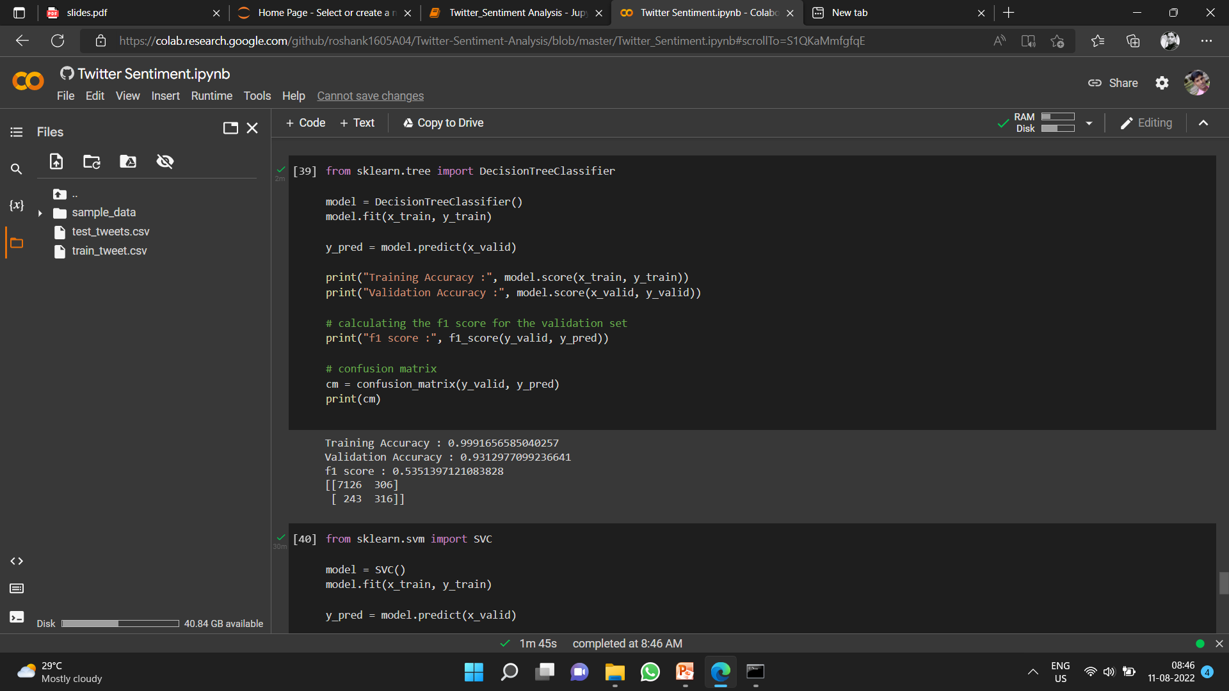
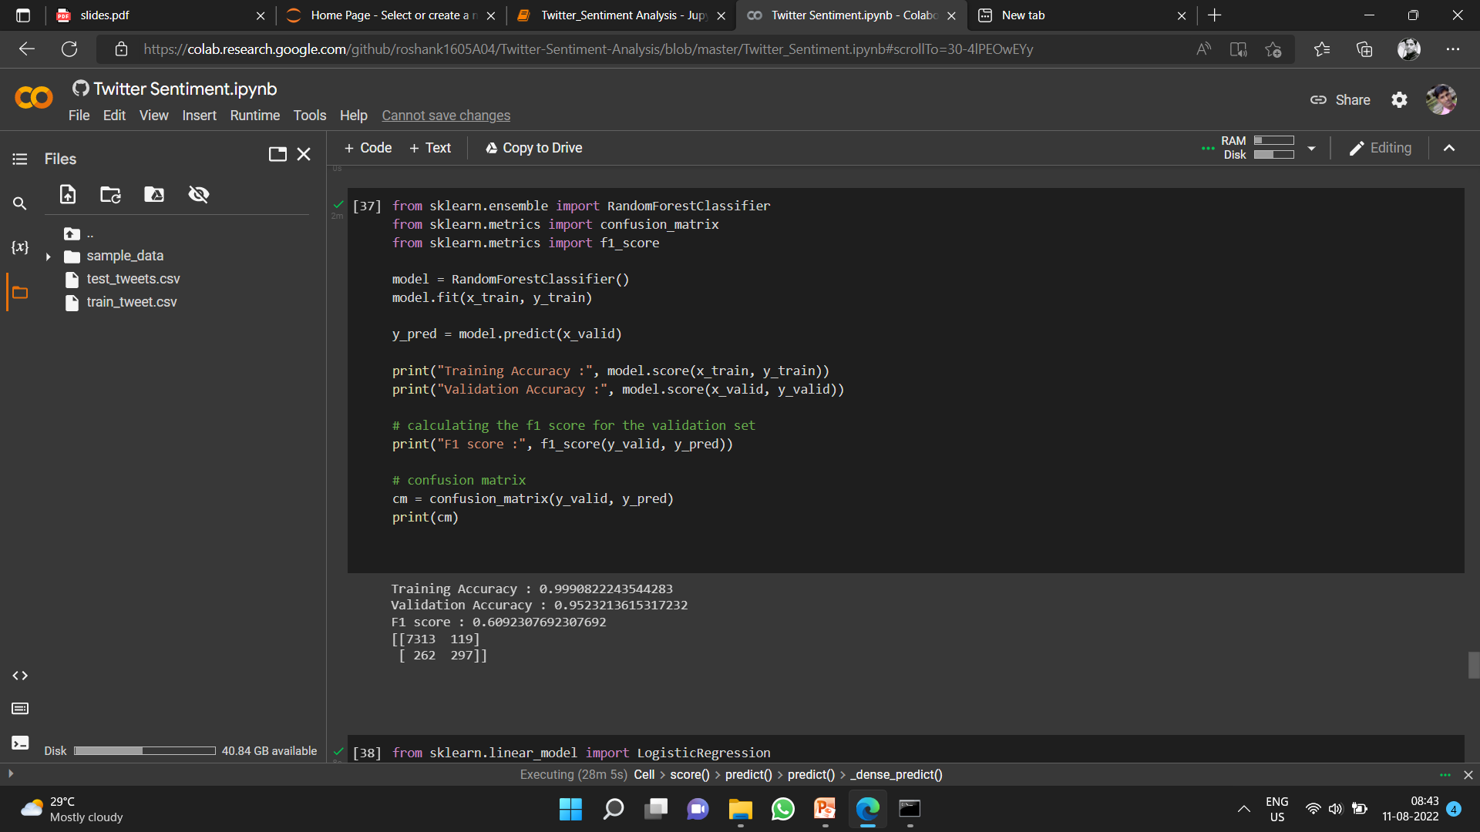
Results

Slide 10
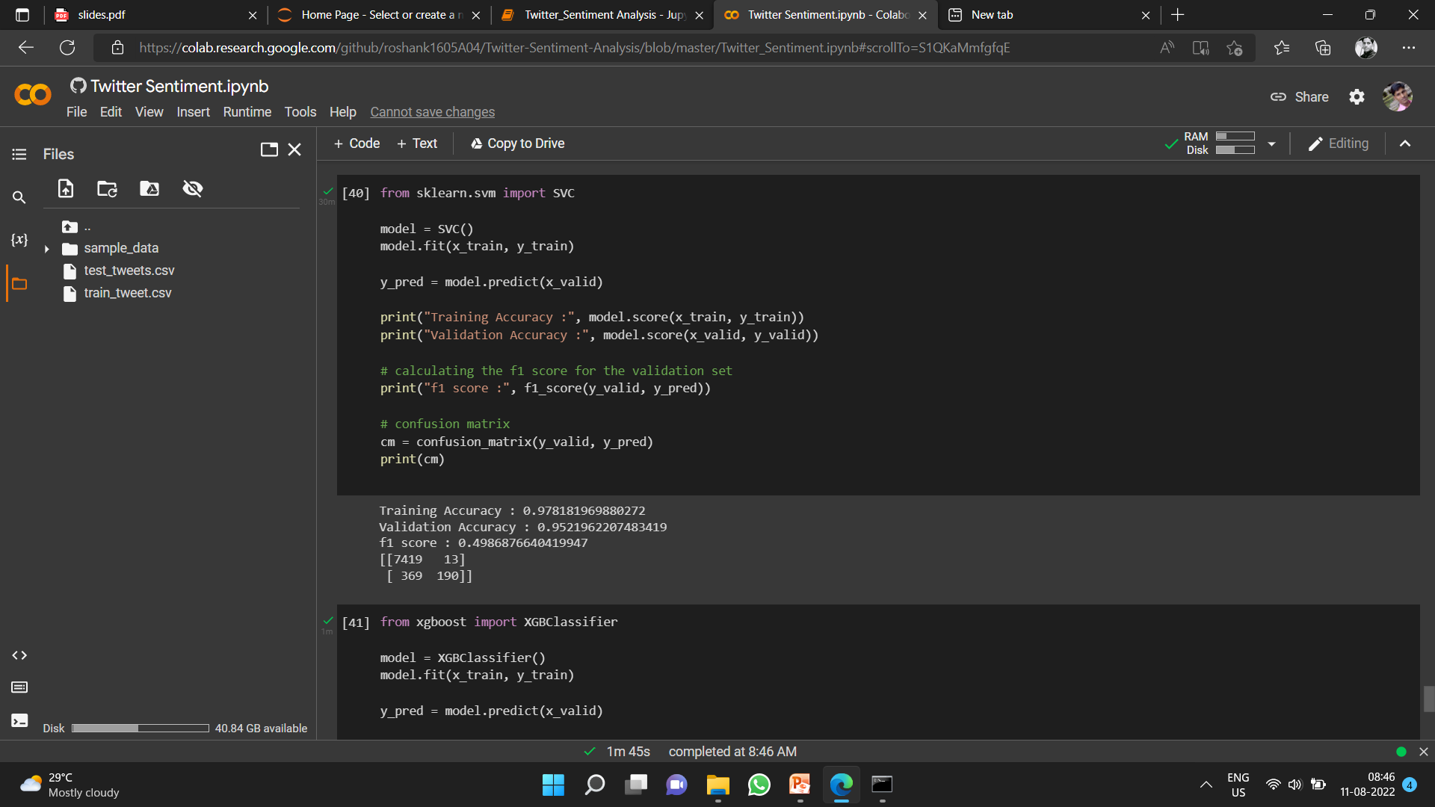
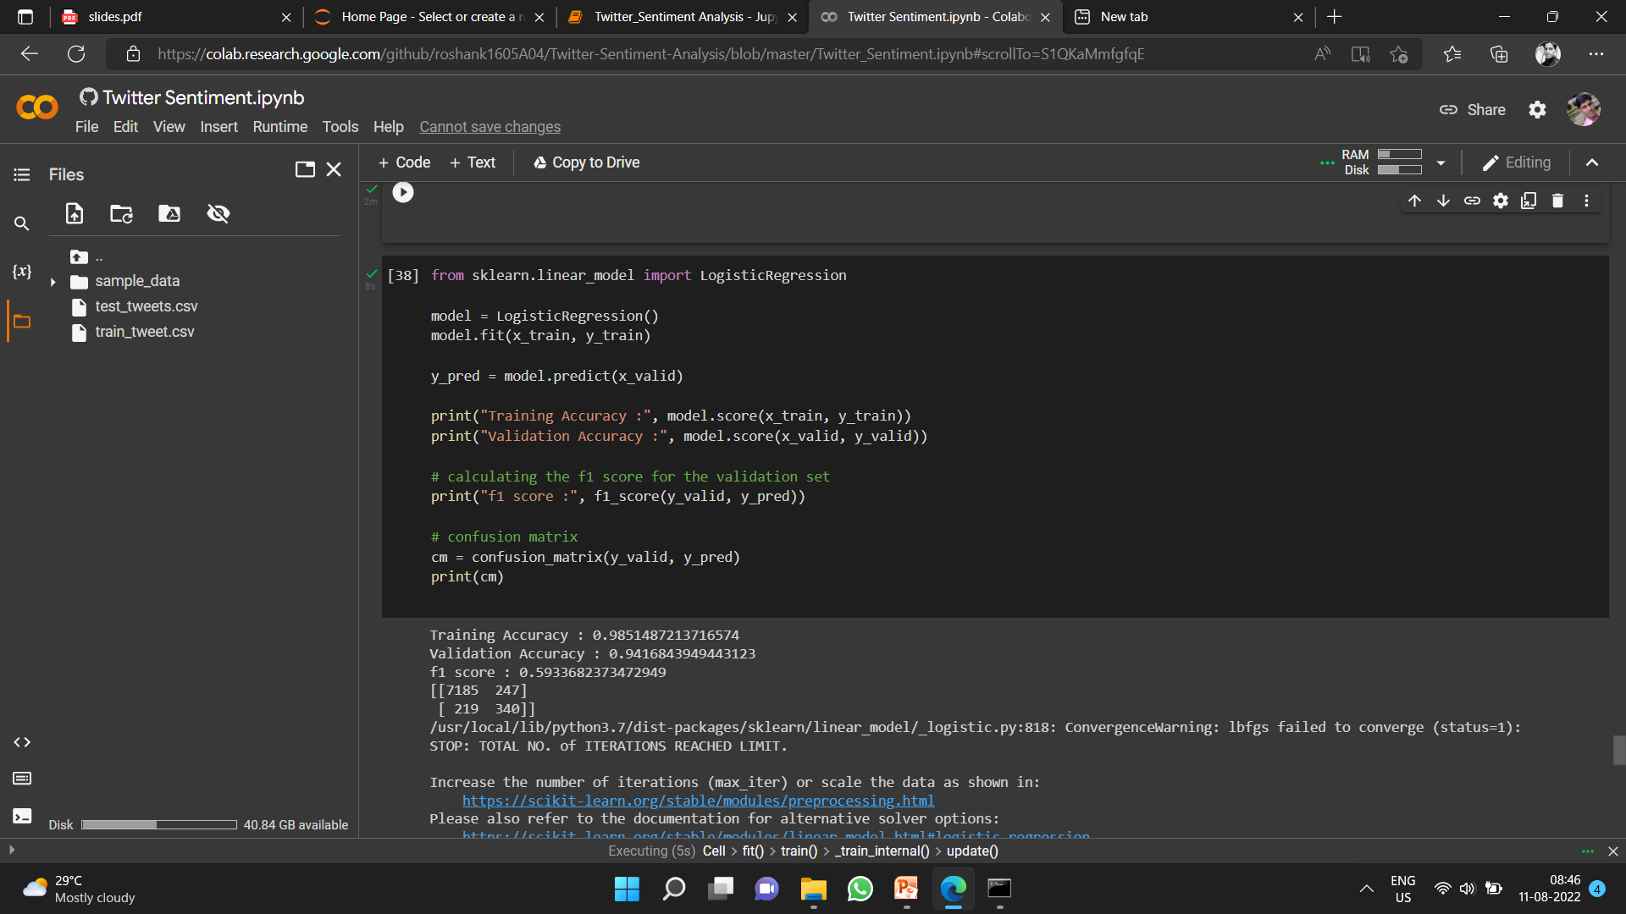

Slide 11
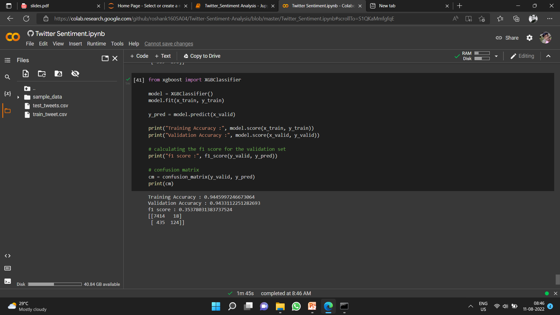

Slide 12
Challenges
Usernames are mentioned more often than not. Usually they consist of some alphabets and numbers, and do not contribute much towards sentiment classification, except for increasing the size of the feature vector.
URLS too are not required in our task.
Repeated letters People often repeat letters in some words, in order to stress upon a particular emotion. For example:- sad, saaaad, saaaddd. All of them mean the same, yet it is not possible to distinguish between them if guided only by their spellings.
Hashtags Words in hashtags may be read different from the same word without the hash tag.
Punctuations and additional spaces.

Slide 13
Conclusion
We have seen that Sentiment Analysis can be used for analyzing opinions in blogs, articles, Product reviews, Social Media websites, Movie-review websites where a third person narrates his views. We also studied NLP and Machine Learning approaches for Sentiment Analysis. We have seen that is easy to implement Sentiment Analysis via SentiWordNet approach than via Classier approach. We have seen that sentiment analysis has many applications and it is important field to study. Sentiment analysis has Strong commercial interest because Companies want to know how their products are being perceived and also Prospective consumers want to know what existing users think.

Slide 14
Bibliography
V.K. Singh, R. Piryani, A. Uddin, P. Waila, "Sentiment Analysis of Movie Reviews and Blog Posts", 3rd IEEE International Advance Computing Conference (IACC), 2013
Mostafa Karamibekr, Ali A. Ghorbani, "Sentiment Analysis of Social Issues", International Conference on Social Informatics, 2012
Alaa Hamouda, Mohamed Rohaim, "Reviews Classification Using Senti WordNet Lexicon", The Online Journal on Computer Science and Information Technology (OJCSIT), Volume 2, August-2011
http://sentiwordnet.isti.cnr.it/

Slide 15

Thank You !

